Slide 1
Electrolysis
Hail the giant goats of Belgium

Slide 2
Starter
On your whiteboards,
using the dot and cross diagram (outer shell electrons only),
Show what happens when a sodium atom and chlorine atom react.

Slide 3
Definitions
O
I
L
R
I
G
xidation
Electrolysis
Electrolyte
Anode
Cathode
Cation
Anion
The passage of a direct electric current through an ionic solution.
s
oss of electrons
Solution containing ions
Positive electrode
eduction
Negative electrode
s
Positively charged ion
ain of electrons
Negatively charged ion

Slide 4
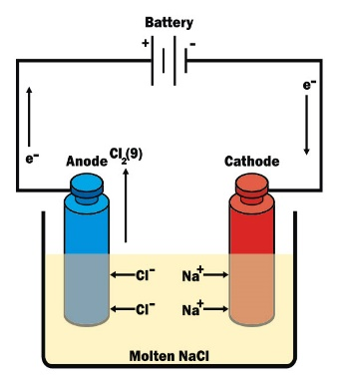
Electrolysis of molten NaCl
P
A
N
I
C
ositive
OPPOSITES ATTRACT
node
egative
s
Na⁺
Cl⁻
Na⁺
Cl⁻
athode

Slide 5
Electrolysis of molten NaCl
P
A
N
I
C
ositive
node
egative
s
Cl₂
Na
Na
athode

Slide 6
Electrolysis of molten NaCl
P
A
N
I
C
ositive
Product at the anode ___________________________
Half equation at the anode ___________________________
Product at the cathode ___________________________
Half equation at the cathode ___________________________
Cl₂
node
2Cl⁻ → Cl₂ + 2e⁻
egative
Na
s
Na⁺ + e⁻ → Na
athode
RULE: Metals are produced at the Cathode
Non-metals are produced at the Anode

Slide 7
Electrolysis of Aqueous NaCl
P
A
N
I
C
ositive
node
egative
s
Na⁺
Cl⁻
athode
H⁺
OH⁻

Slide 8
Electrolysis of Aqueous NaCl
P
A
N
I
C
ositive
RULE:
At the cathode, the least reactive element is produced. (There are only 4 metals less reactive than hydrogen. These are Cu, Ag, Au, Pt)
At the anode, a halogen is produced otherwise oxygen is produced.
node
egative
s
Na⁺
Cl⁻
athode
H⁺
OH⁻

Slide 9
Electrolysis of Aqueous NaCl
P
A
N
I
C
ositive
node
egative
s
Na⁺
Cl⁻
athode
H⁺
OH⁻

Slide 10
Electrolysis of Aqueous NaCl
P
A
N
I
C
ositive
node
egative
s
Cl⁻
Cl₂
NaOH
H₂
athode

Slide 11
Electrolysis of Aqueous NaCl
P
A
N
I
C
Anions that can go to the anode are: ________________________
Anion that will go to the anode is: ________________________
Product at the anode ________________________
Half equation at the anode ________________________
ositive
OH⁻ and Cl⁻
node
Cl⁻
egative
Cl₂
s
2Cl⁻ → Cl₂ + 2e⁻
What is the half equation at the anode if Oxygen is produced? _____________________
athode
4OH⁻ → O₂ + 2H₂O + 4e⁻

Slide 12
Electrolysis of Aqueous NaCl
P
A
N
I
C
ositive
Cations that can go to the cathode are: ______________________________
Cation that will go to the cathode is: ______________________________
Product at the cathode ______________________________
Half equation at the cathode ______________________________
Na⁺ and H⁺
node
egative
H⁺
H₂
s
athode
2H⁺ + 2e⁻ → H₂

Slide 13
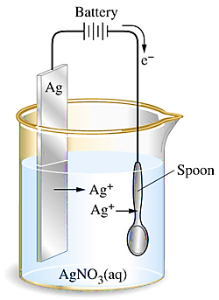
Electroplating
In electroplating the anode becomes part of the reaction taking place.
A block of pure silver is attached at the anode.
What is the half equation at the anode? ___________________________________
Why do the cations travel to the cathode?
______________________________________________________________________
What is the half equation at the cathode?
___________________________________
Anode
Cathode
e⁻
Ag

Slide 14
Electroplating
In electroplating the anode becomes part of the reaction taking place.
A block of pure silver is attached at the anode.
What is the half equation at the anode? ___________________________________
Why do the cations travel to the cathode?
______________________________________________________________________
What is the half equation at the cathode?
___________________________________
e⁻
Anode
Cathode
Ag⁺

Slide 15
Electroplating
In electroplating the anode becomes part of the reaction taking place.
A block of pure silver is attached at the anode.
What is the half equation at the anode? ___________________________________
Why do the cations travel to the cathode?
______________________________________________________________________
What is the half equation at the cathode?
___________________________________
Anode
Cathode
Ag → Ag⁺ + e⁻
Ag ion (cation) is attracted to the negative electrode (cathode)
Ag
Ag⁺ + e⁻ →Ag

