Slide 1
Organic chemistry –hydrocarbons

Slide 2
Question 1
The molecular formulae of the first three members of the alkane hydrocarbons are CH₄, C₂H₆, and C₃H₈.
What is the molecular formula of the eighth alkane member, octane, which is found in petrol?
A. C₈H₈
B. C₈H₁₆
C. C₈H₁₈
D. C₈H₂₀

Slide 3
Question 2
Crude oil is a …
A. … complicated organic compound.
B. … mixture of various organic liquids.
C. … saturated solution of various organic gases dissolved in oil.
D. … saturated solution of various organic solids dissolved in oil.

Slide 4
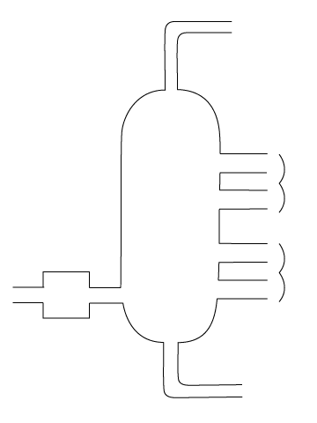
Question 3
The diagram shows a fractionating column used for the separation of crude oil.
At which position A, B, C or D would the fraction be produced which, when heated with gravel and sand, is used for road surfacing?
A
B
Crude oil
C
D
Fractionating column

Slide 5
Question 4
Petroleum can be separated into various fractions because each of its fractions has a different ...
A. … boiling point.
B. … colour.
C. … density.
D. … flammability.

Slide 6
Question 5
If you crack a molecule like octadecane, C₁₈H₃₈, what would be a likely product?
A. C₉H₁₈
B. C₁₈H₃₆
C. C₃₆H₇₄
D. C0₂

Slide 7
Question 6
Finish the sentence.
Alkanes …
A. … are always colourless gases.
B. … are more reactive than alkenes.
C. … are water soluble.
D. … contain singe covalent bonds.

Slide 8
Question 7
Which equation correctly shows the complete combustion of ethane gas (C₂H₆)?
A. C₂H_{6(g)} + O_{2(g)} → CO_{2(g)} + H₂O_{(g)}
B. C₂H_{6(g)} + 3O_{2(g)} → 2CO_{2(g)} + 3H₂O_{(g)}
C. 2C₂H_{6(g)} + 6O_{2(g)} → 4CO_{2(g)} + 6H₂O_{(g)}
D. 2C₂H_{6(g)} + 7O_{2(g)} → 4CO_{2(g)} + 6H₂O_{(g)}

Slide 9
Question 8
Methane gas burns in a plentiful supply of air according to the equation:
CH_{4(g)} + 2O_{2(g)} → CO₂ + 2H₂O_{(g)}
If 64 g of methane gas was burnt, what would be the maximum mass of carbon dioxide released into the atmosphere?
(Ar of C = 12, H = 1, O = 16)
A. 44 g
B. 64 g
C. 88 g
D. 176 g

Slide 10
Question 9
Which of these hydrocarbons would have no effect on an aqueous solution of bromine?
A. CH₄
B. C₂H₄
C. C₃H₆
D. C₁₀H₂₀

Slide 11
Question 10
What is (are) the main product(s) when ethene is reacted with bromine gas?
A. Bromoethane only
B. Bromoethane and hydrogen bromide
C. Dibromoethane only
D. Dibromoethane and hydrogen bromide

Slide 12
Question 11
The table compares alkanes and alkenes.
Which of the comparisons is incorrect?
 | Alkanes | Alkenes
A | Do not burn in air | Do burn in air
B | Do not react with steam | Do react with steam
C | Do not decolourise bromine gas | Do decolourise bromine gas
D | Have a general formula C_{n}H_{2n+2} | Have a general formula C_{n}H_{2n}

Slide 13
Question 12
An alkene reacted with bromine to produce a molecule with the following displayed structural formula:
H
Br
Br
H
H
C
C
C
C
H
H
H
H
H
C
H
H

Slide 14
Question 12
Which is the correct displayed
structural formula of the
original alkene?
H
Br
Br
H
H
C
C
C
C
H
H
H
H
H
C
H
H
A
H
H
H
H
B
H
H
H
H
H
C
C
C
=
C
H
H
C
C
=
C
C
H
H
H
C
H
H
H
H
H
C
H
H
H
C
D
H
H
H
H
H
H
C
C
=
C
C
H
H
C
C
=
C
=
C
H
H
H
H
H
C
H
H
C
H
H
H

Slide 15
Question 13
How many different displayed structural formula are there with a molecular formula of C₃H₇Br?
A. 1
B. 2
C. 3
D. 4

Slide 16
Question 14
Which of these hydrocarbons could react with steam to from an alcohol?
I. C₂H₄ II. C₃H₆ III. C₅H₁₀
A. I and II
B. I and III
C. II and III
D. I, II and III

Slide 17
Question 15
Alkynes are a group of hydrocarbon molecules with a general formula of C_{n}H_{2n-2}.
They have a triple carbon-carbon bo .
What is the molecular formula of the third member of this group of hydrocarbons called propyne?
A. C₃H₂
B. C₃H₃
C. C₃H₄
D. C₃H₆

