Slide 1
Covalent bonding
H
N
H
Cl
H
H
O
C
O

Slide 2
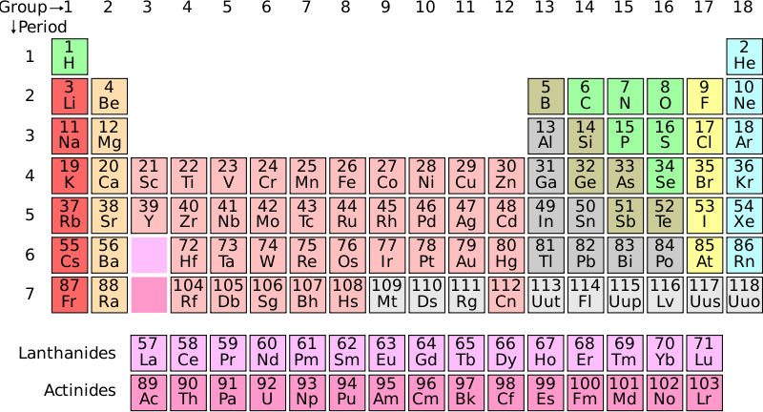
Bonding
Hi. My name’s Johnny Chlorine. I’m in Group 7, so I have 7 electrons in my outer shell
Cl
I’d quite like to have a full outer shell. To do this I need to GAIN an electron. Who can help me?
Cl

Slide 3
Bonding
Cl
Here comes one of my friends, Harry Hydrogen.
Hey Johnny Chlorine. I’ve only got one electron but it’s really close to my nucleus so I don’t want to lose it. Fancy sharing?
H
Cl
H
Now we’re both really stable. We’ve formed a covalent bond.

Slide 4
Covalent bonding
Consider an atom of hydrogen:
Notice that hydrogen has just ___ electron in its outer shell. A full (inner) shell would have ____ electrons, so two hydrogen atoms get together and “_____” their electrons:
1
2
share
Now they both have a ____ outer shell and are more ______. The formula for this molecule is H₂.
full
stable
Missing words
gas covalent non-metal 1 2 liquid share full weak stable

Slide 5
Covalent bonding
When two or more atoms bond by sharing electrons we call it _________ bonding. This type of bonding normally occurs between __________ atoms. It causes the atoms in a molecule to be held together very strongly but there are ______ forces between individual molecules. This is why covalently-bonded molecules have low melting and boiling points (i.e. they are usually _____ or ________).
covalent
non-metal
weak
gas
liquid
Missing words
gas covalent non-metal 1 2 liquid share full weak stable

Slide 6
Dot and cross diagrams
Step 1: Draw the atoms with their outer shell.
Step 2: Put the atoms together and check they all have a full outer shell.
Example 1: water, H₂O
H
O
H
O
H
H
Example 2: oxygen, O₂:
O
O
O
O

Slide 7
Dot and cross diagrams
Task
Can your draw diagrams for these molecules?
nitrogen, N₂:
methane CH₄:
H
N
N
H
C
H
H

Slide 8
Dot and cross diagrams
Task
Can your draw diagrams for these molecules?
ammonia NH₃:
methane CH₄:
H
N
H
O
C
O
H

