Slide 1
Controlling fertility quizzes

Slide 2
Quiz 1 – contraception

Slide 3
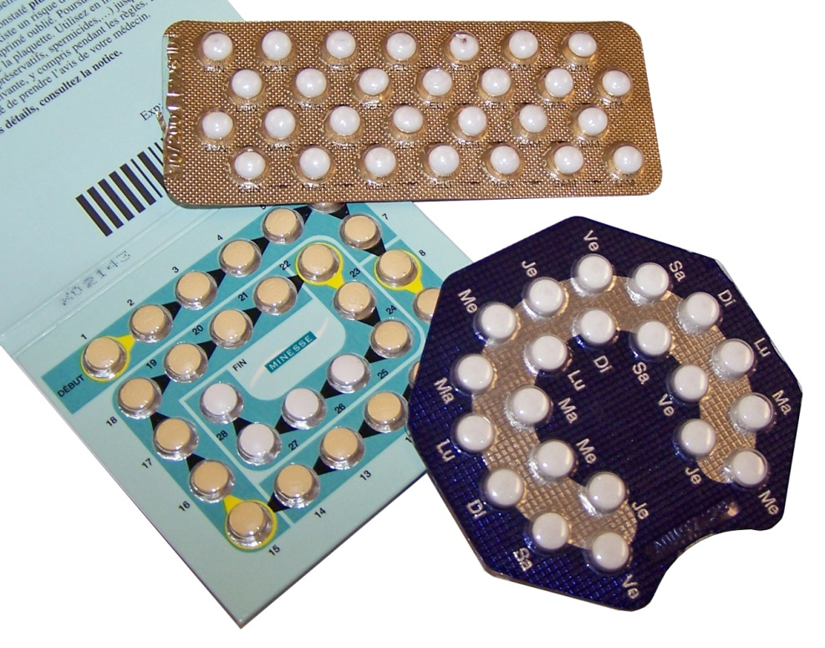
Which contraceptive is this?
Clue 1
Contains hormones to inhibit FSH production so that no eggs mature.
Check answer
Oral contraceptives
Notes:
Ceridwen, 2006, commons.wikimedia.org/wiki/Category:Contraceptive_pills#/media/File:Plaquettes_de_pilule.jpg

Slide 4
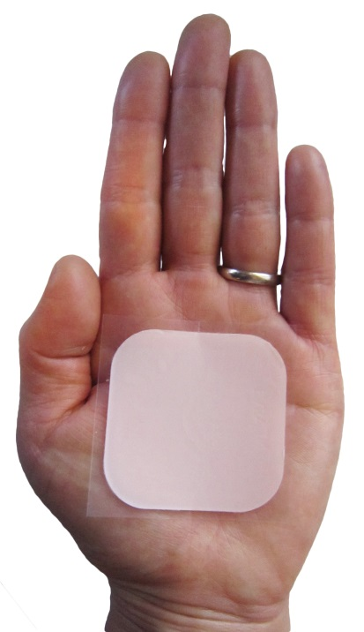
Which contraceptive is this?
Clue 2
A slow release progesterone contraceptive to inhibit the maturation and release of eggs for a number of months or years.
Check answer
Injection, implant or skin patch
Notes:
James Hellman, MD, 2013, commons.wikimedia.org/wiki/File:BirthControlPatch.JPG

Slide 5
Which contraceptive is this?
Clue 3
Barrier methods to prevent sperm reaching eggs.
Check answer
Condoms and diaphragms
Notes:
Timothy Takemoto, 2005, commons.wikimedia.org/wiki/Category:Empty_condoms#/media/File:Condom_traffic_light.jpg

Slide 6
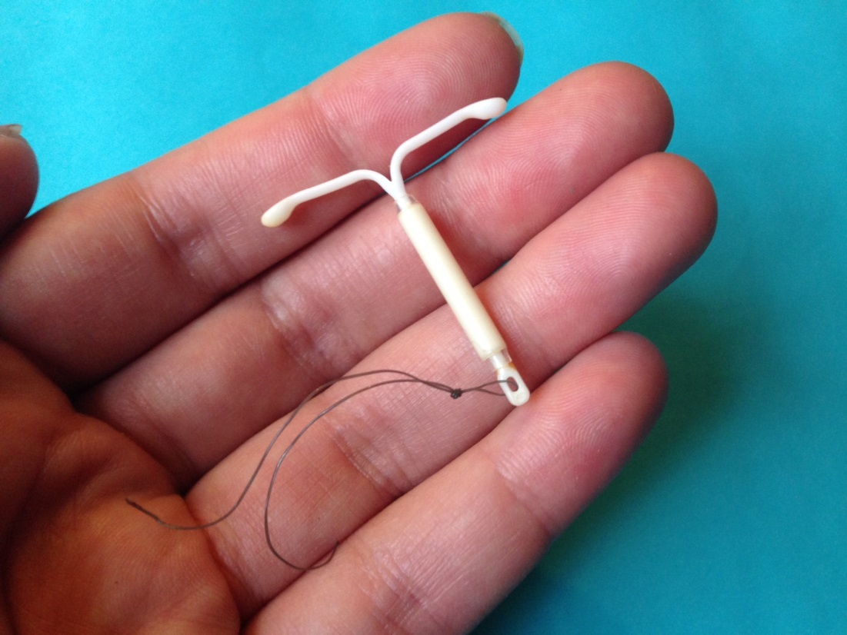
Which contraceptive is this?
Clue 4
Prevents the implantation of an embryo.
Check answer
Intrauterine devices (IUDs)
Notes:
Sarahmirk, 2016, commons.wikimedia.org/wiki/File:Mirena_IUD_with_hand.jpg#/media/File:Mirena_IUD_with_hand.jpg

Slide 7
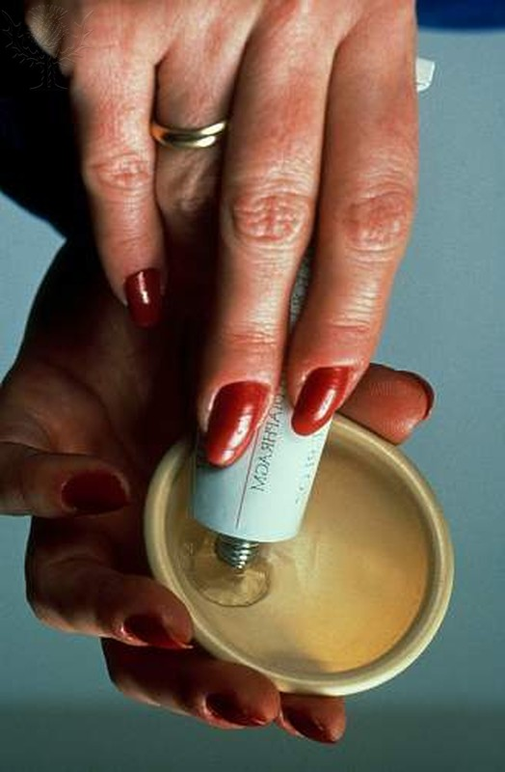
Which contraceptive is this?
Clue 5
Kills or disables sperm.
Check answer
Spermicide
Notes:
Diaphragm with spermicide / Credit: Southern Illinois University/ Photo Researchers / Universal Images Group / Copyright © Southern Illinois University / For Education Use Only. This and millions of other educational images are available through Britannica Image Quest. For a free trial, please visit www.britannica.co.uk/trial

Slide 8
Which contraceptive is this?
Clue 6
Sperm ducts or oviducts are cut and tied.
Check answer
Surgical sterilisation
Notes:
Surgery / Credit: Michelle Del Guercio / Photo Researchers / Universal Images Group / Copyright © Michelle Del Guercio / For Education Use Only. This and millions of other educational images are available through Britannica Image Quest. For a free trial, please visit www.britannica.co.uk/trial

Slide 9
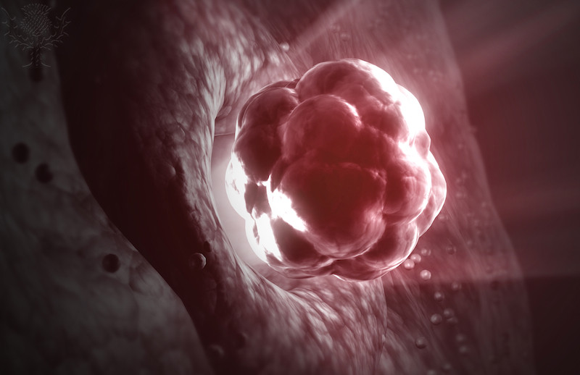
Which contraceptive is this?
Clue 7
No sexual intercourse around ovulation.
Check answer
Abstinence
Notes:
Ovulation / Credit: 3D4Medical / Universal Images Group / Copyright © 3D4Medical / For Education Use Only. This and millions of other educational images are available through Britannica Image Quest. For a free trial, please visit www.britannica.co.uk/trial

Slide 10
Quiz 2 – infertility treatment

Slide 11
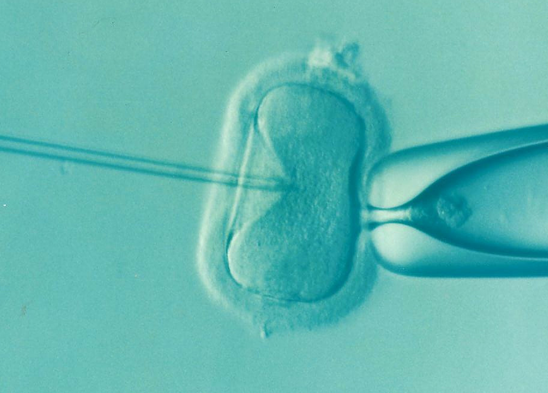
Infertility treatments
Question 1
What does IVF stand for?
Check answer
In vitro fertilisation

Slide 12
Infertility treatments
Question 2
IVF involves giving a mother two hormones,
what are they?
Check answer
FSH and LH

Slide 13
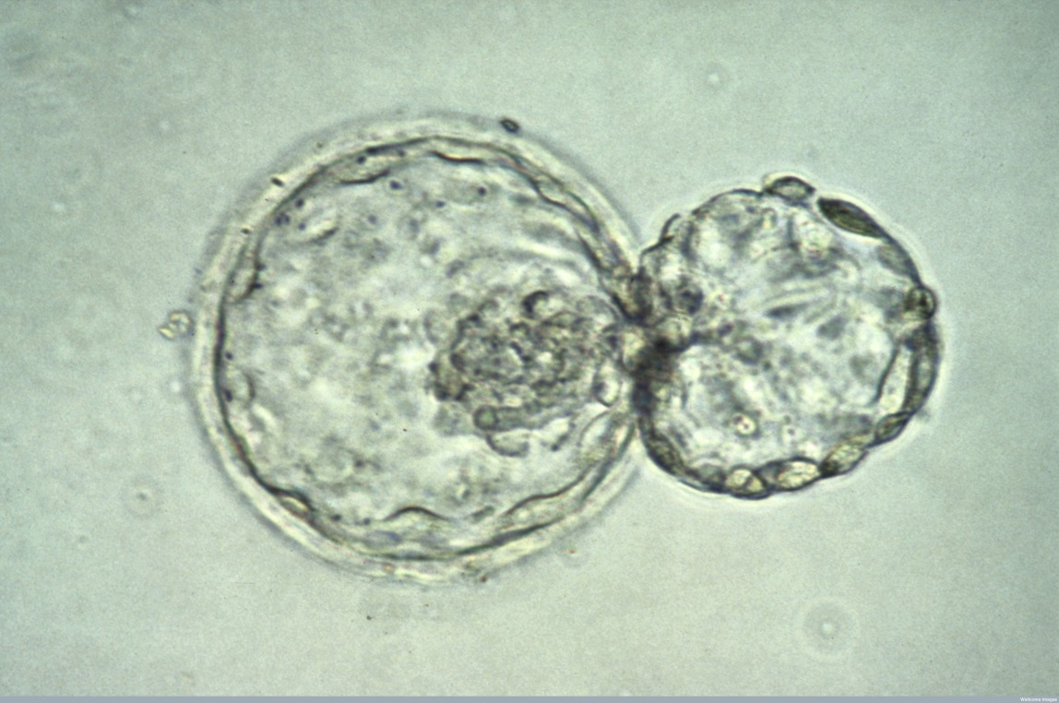
Infertility treatments
Question 3
Why is the mother given FSH and LH during IVF?
Check answer
To stimulate the maturation of several eggs.
Notes:
Wellcome Library, London

Slide 14
Infertility treatments
Question 4
What are the stages in IVF after the eggs and sperm have been collected?
Check answer
Using sperm from father, the eggs are fertilised in the lab.
The fertilised eggs develop into embryos.
At the stage when they are tiny balls of cells, one or two embryos are inserted into the mother's uterus (womb).
Notes:
Wellcome Library, London

Slide 15
Infertility treatment
Question 5
What is an advantage of IVF?
Check answer
Gives a woman the chance to have a baby of her own.

Slide 16
Infertility treatments
Disadvantages of IVF?
Question 6
What are the disadvantages of IVF?
Check answer
Emotionally and physically stressful.
Success rates are not high.
Can lead to multiple births which are a risk to both the babies and the mother.

